Slide 1
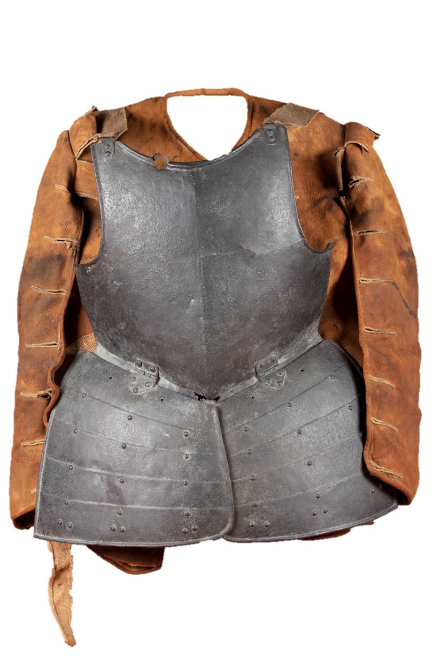



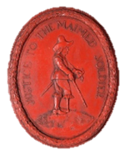
Fight a battle
Find a battlefield
Solve a mystery
Meet some soldiers
Soldiers

Slide 2


Meet some
Civil-War Soldiers!
Soldiers

Slide 3
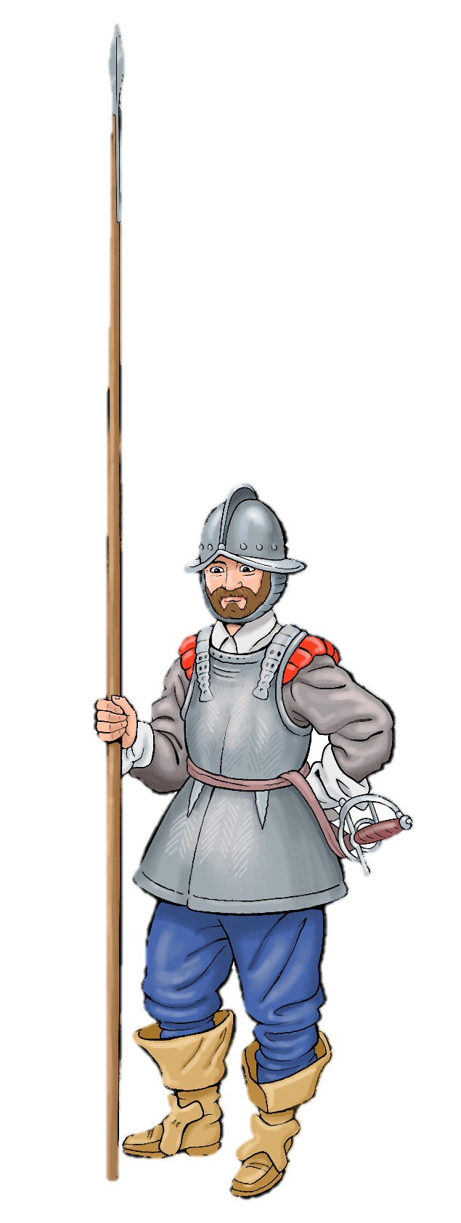
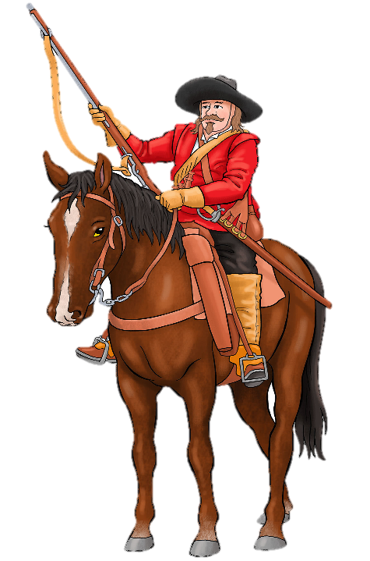
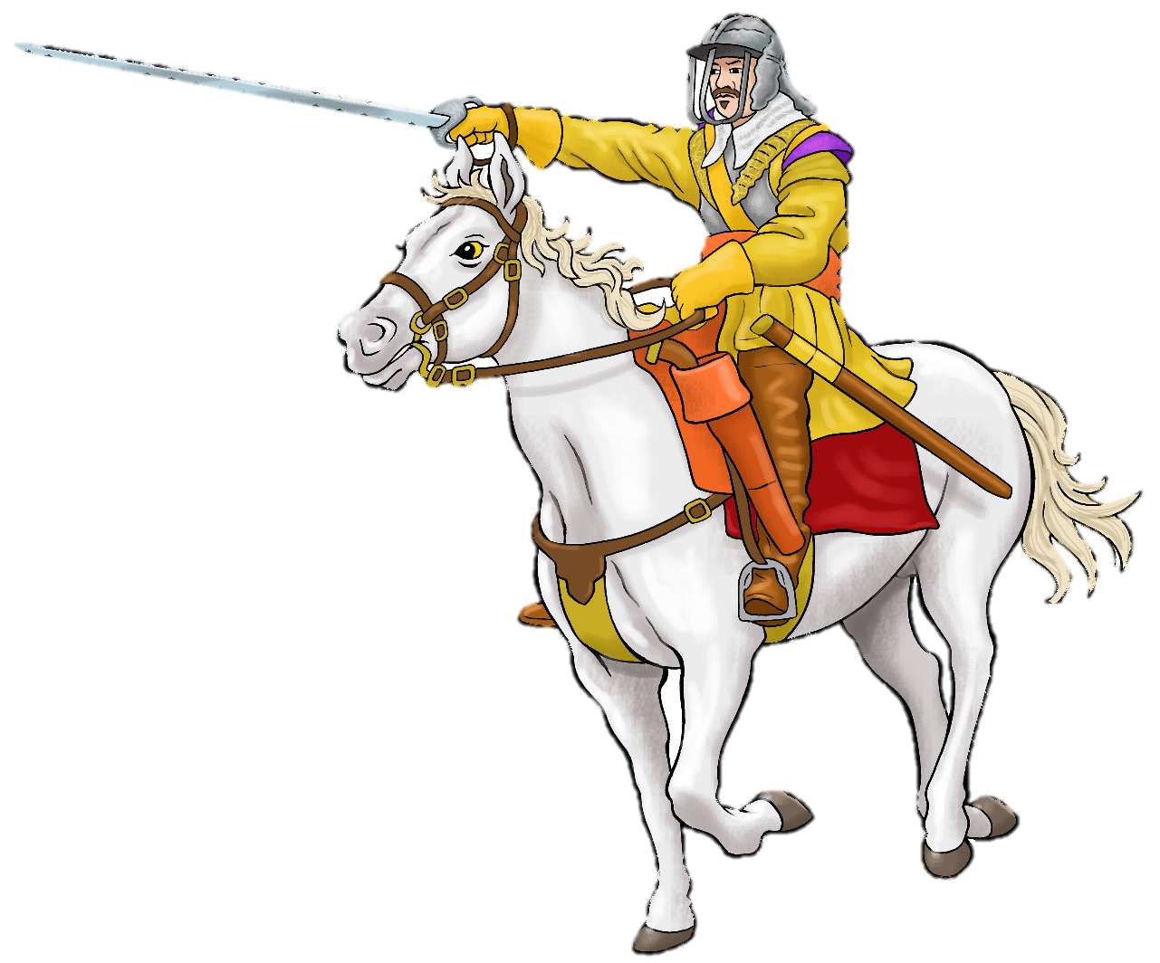
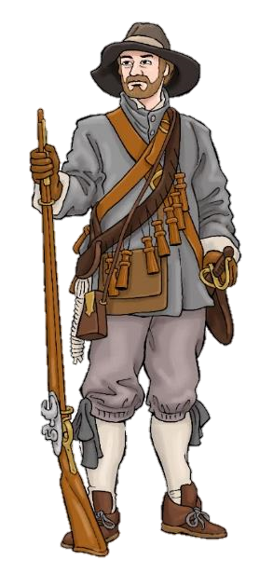
Soldiers fought in groups called regiments.
Each regiment had a different job to do on the battlefield.
Meet a Civil War Soldier

Slide 4
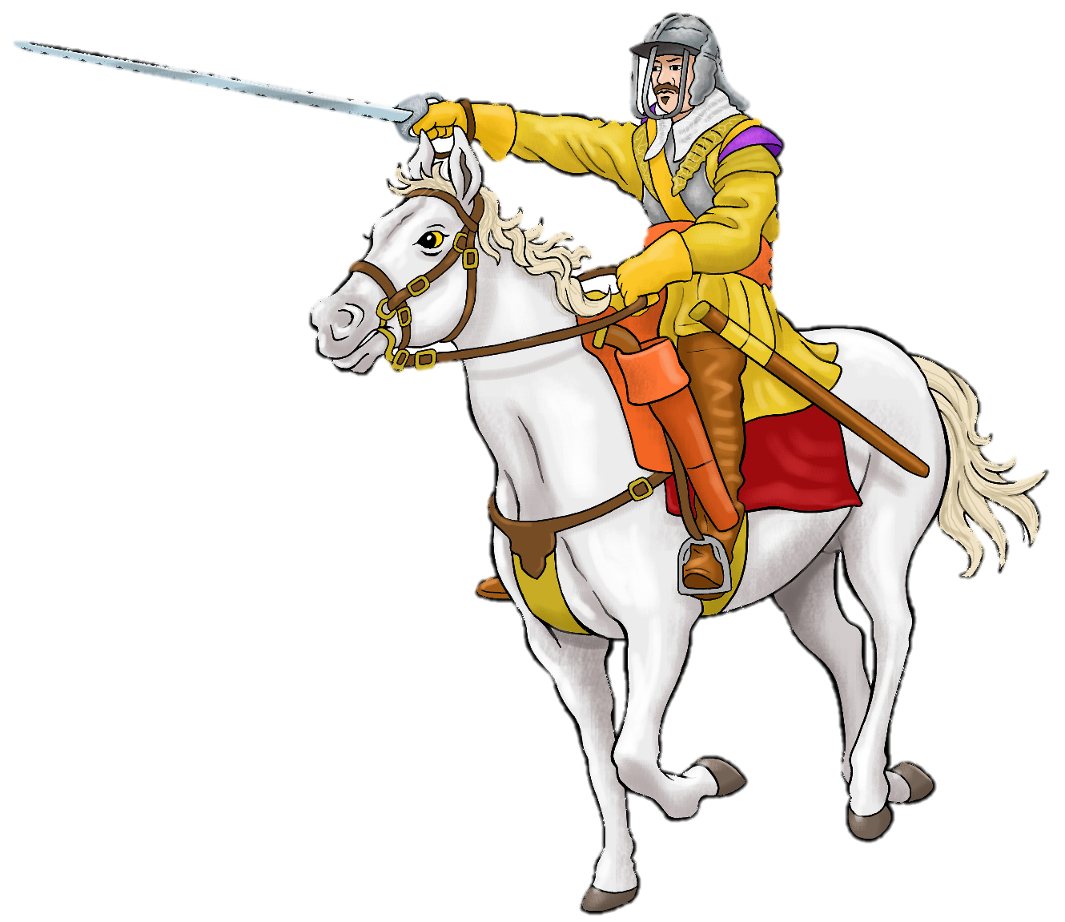
Cavalry
These soldiers fought on horseback
They carried pistols or a larger gun called a carbine.
They had a sharp sword.
Cavalry

Slide 5
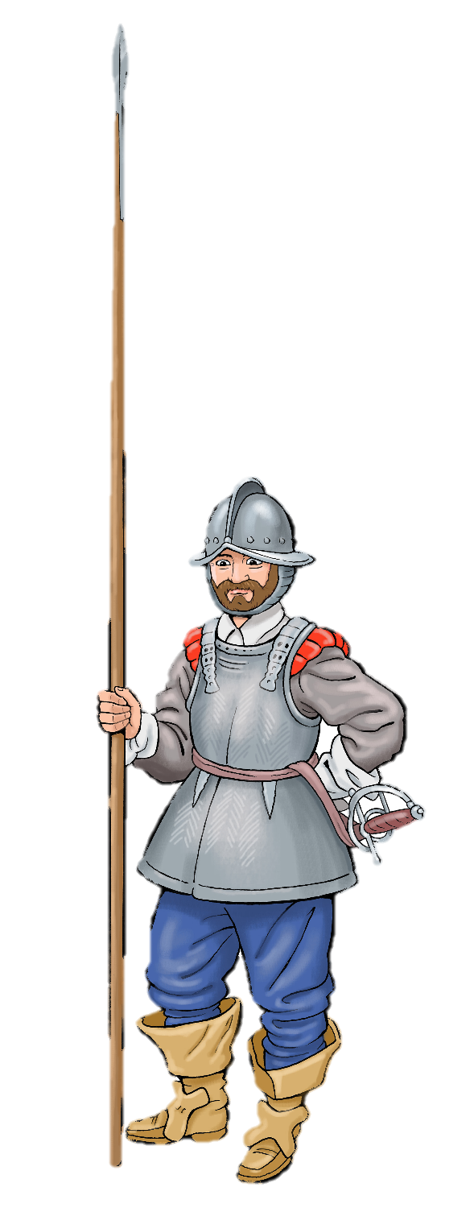
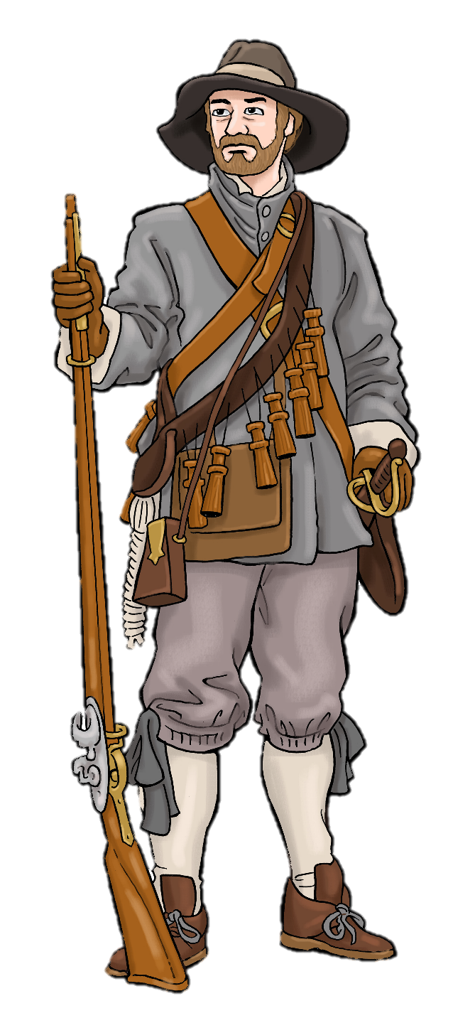
Infantry
These soldiers fought on foot.
The infantry was made up of Pikemen and Musketeers
Infantry

Slide 6
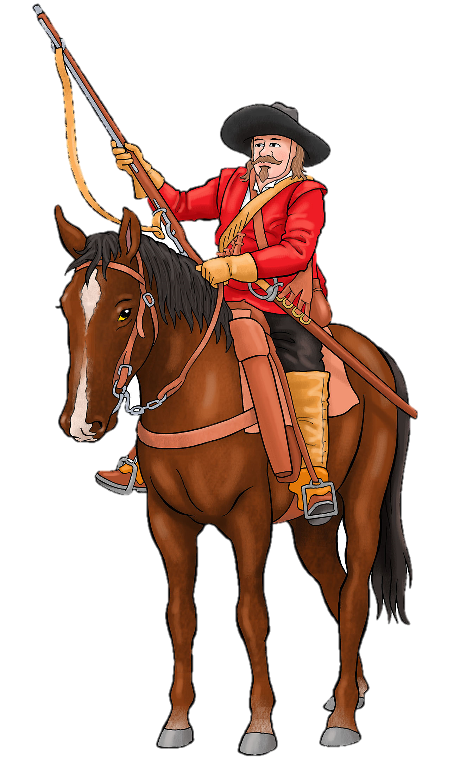
Dragoons
These were mounted infantry soldiers.
They used horses to transport them quickly around the battlefield.
They usually dismounted to fight.
Dragoons

Slide 7


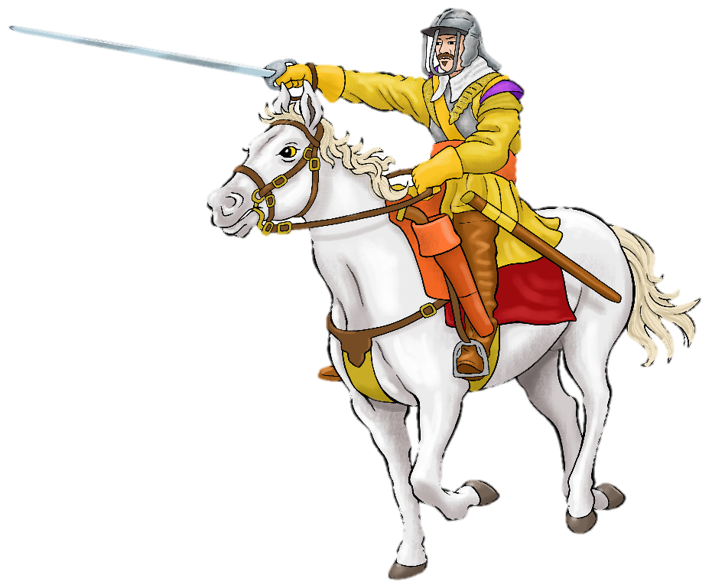
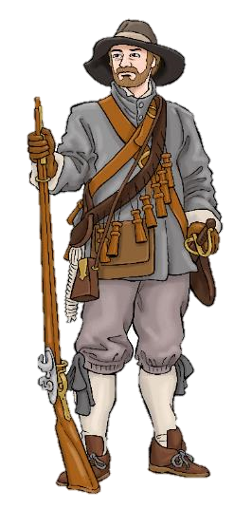
Read and listen to what each soldier says.
Use the worksheets to make your own labelled diagram of their equipment.
Meet a Civil War Soldier

Slide 8

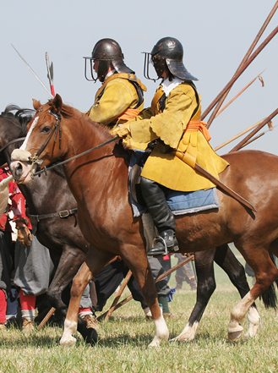
Can you remember what kind of soldier this is?

Slide 9


I am a Captain of Horse. That means I fight in the cavalry. My men are called troopers. Watch out! I can move fast! I am wearing armour, only a breastplate and back plate. My lobster pot helmet has three bars to protect my face from enemy swords. Under my armour, I am wearing a thick leather buff coat. This gives me even more protection from bullets and swords and makes my armour more comfortable. My left hand is holding the horse’s bridle. It is protected by a glove called a gauntlet. With my right hand I swing a good, sharp sword that I slash down on my enemies! I also have two pistols that I carry in saddle bags in front of me or tie to my wrists. Some cavalry soldiers carry a carbine, a gun like a musket but shorter. This horse is called Ned. He is five years old and well trained. I grew up hunting on my father’s estate, so I am an excellent rider. I am paid more than other soldiers, but my horse’s food comes out of my wages. On the battlefield the cavalry form up in lines (or ranks) and trot towards the enemy. Then, when we are about 100 metres away, we charge close together at high speed!
Click here to listen
Cavalry

Slide 10
Can you remember what kind of soldier this is?

Slide 11
I am a dragoon. That means I fight on foot but I have a horse to ride on so that I can move quickly around the battlefield. I carry a flintlock musket which is easier than a matchlock musket to reload on horseback. The sling hanging from it helps me carry it on my back. I am wearing a bandolier, a belt onto which 12 bottles are tied. Each bottle has one charge of gunpowder for loading my gun. I also have a pouch for round lead bullets. My sword isn’t very sharp. I am more likely to use it to kill chickens or chop firewood than attacking the enemy! I wear leather boots and gaters to protect my legs from the straps from which my stirrups hang- they pinch me when I am riding. The cavalry look down on us but we dragoons help win battles. At the battle of Naseby we hid behind hedges and ambushed the enemy!
Click here to listen
Dragoon

Slide 12
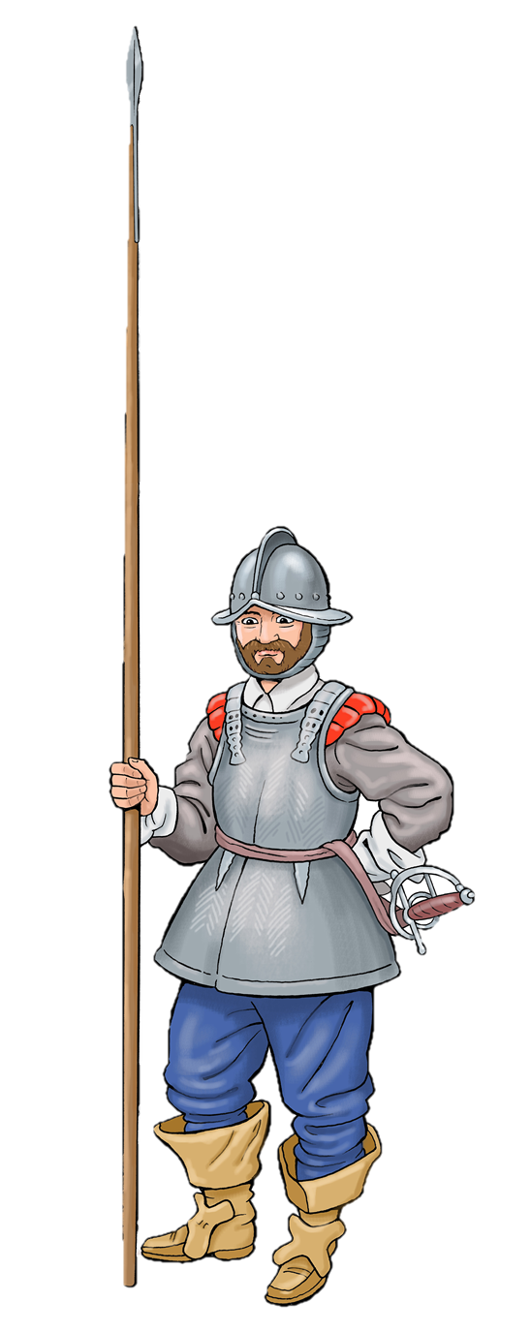
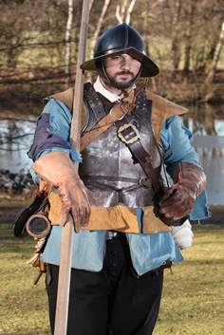
Can you remember what kind of soldier this is?

Slide 13
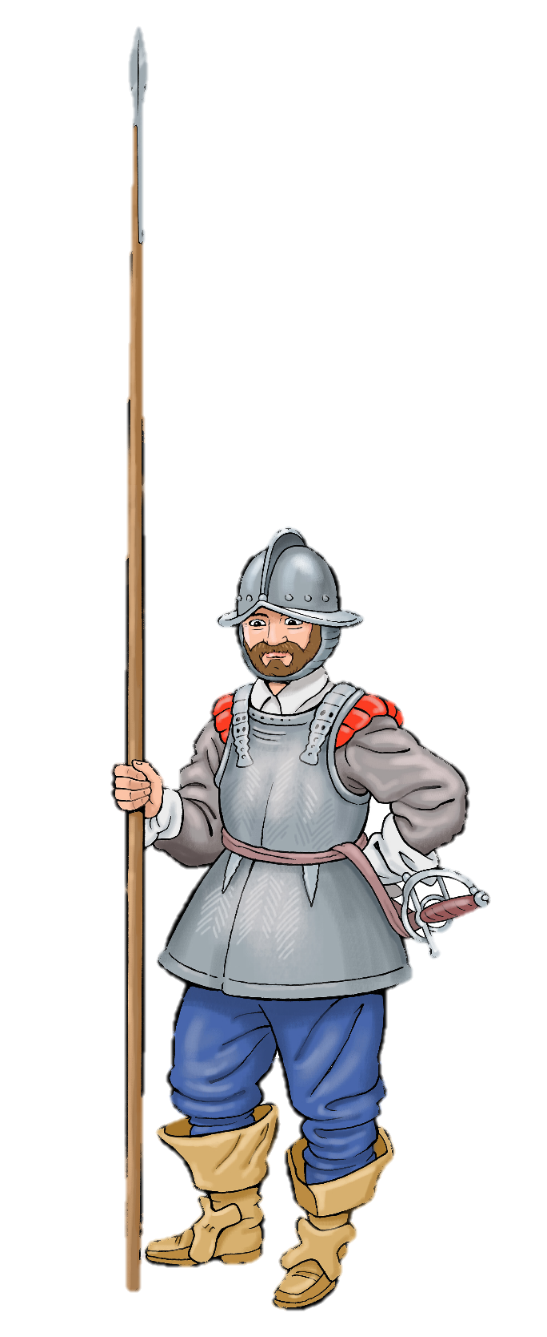
I am an infantry soldier, a Pikeman. That means I fight on foot and carry a pike with a sharp spike on the end. Not all of us are professionals but I have lots of experience of fighting. I have even fought abroad in Europe. You may think this weapon looks easy to handle but it is very heavy! It is 18 feet long (5.5 metres) and it takes a lot of practice to move it, let alone kill with it!
Pikemen can defend the infantry against cavalry charges. We stand close to one another and hold our pikes at an angle to make a wall of spikes that will stop horses. When our company attacks, we look like a giant charging hedgehog. When we meet the enemy, we push against them until one side breaks and runs.
I am wearing heavy armour with tassets that protect my legs. This kind of armour is rare now because it is so heavy. I also have a pot helmet made in two pieces with a brim that tilts up to stop enemy blades. I have a sword in case I lose my pike and need to fight at close range, but it isn’t the best quality.
Click here to listen
Pikeman

Slide 14

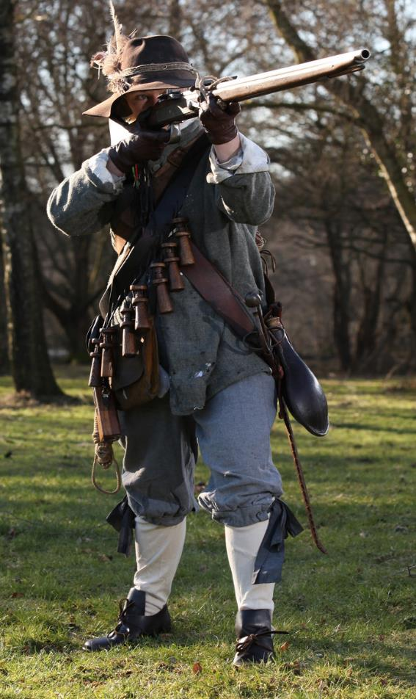
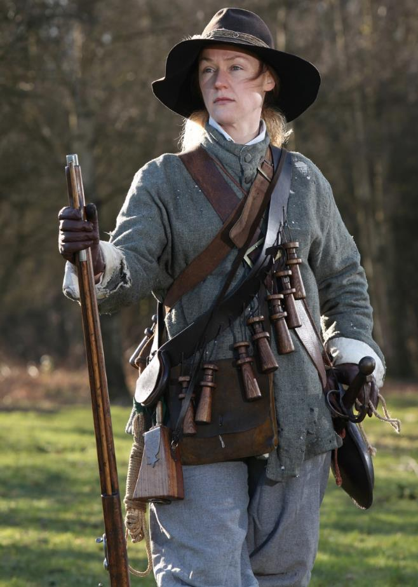
Can you remember what kind of soldier this is?

Slide 15

Before the war I worked in the fields around my village. Now, I am an infantry soldier, a musketeer. That means I fight on foot and carry a matchlock musket. We have no uniform, but I was given a woollen jacket that is warm and will not burn. I fight in a company of 50 or 60 men and we line up in ranks. They say this gun is ‘the sure and sore messenger of death’. I don’t know about ‘sure’- it’s heavy and does not always hit where I aim! We are only powerful if each rank fires at the same time and reloading is slow, 30 seconds or more. Practice makes us faster and each rank takes turns to reload so we can keep a steady rain of bullets falling upon on our enemy. I have a sword to use in case I run out of bullets. I would rather kill my enemy with the club end of my musket and save this cheap sword for cutting firewood!
The bandolier across my chest has 12 bottles, each filled with a measure of gunpowder. I put some in the powder pan and more in the barrel of the gun. I carry a bullet pouch but it’s hard to reach the lead musket balls inside during the fighting, so I put them in my mouth and spit them into the barrel when I need them. Sometimes I make the bullets myself, melting down any lead we find as we travel. God forgive us, but we have used lead from a church roof and even a church organ! If the bullets don’t fit in the gun barrel, I shave or bite them until they do. Then, I ram the bullet down into the barrel with a scouring stick.
The piece of rope in my hand is called a match. It is soaked in ‘saltpetre’ to keep it burning all the time. I place the match onto a hook on the gun. It’s called ‘the serpent’ because it looks like a snake. When I pull the trigger, the serpent dips the match into the powder pan and… boom! The fire travels through a hole into the gun’s barrel and out shoots the bullet.
Finding food and water is hard on the march. We are promised bread, beer, oatmeal, cheese, meat and biscuits but we often go hungry or take what we need from local people.
Click here to listen
Musketeer

